Slide 1

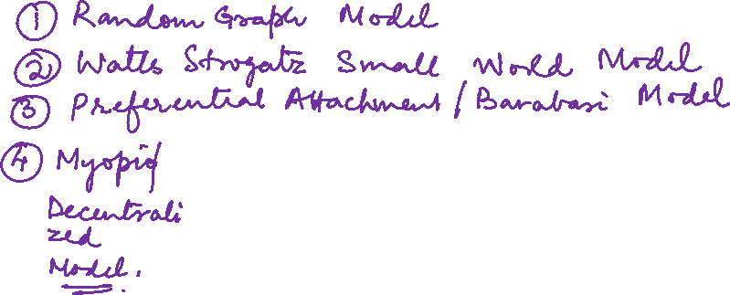
Graph Theory and its Applications
Myopic or Decentralized Search
Dr. Arti Arya
Department of Computer Science
and Engineering

Slide 2

Graph Theory and its Applications
Recap of Milgram’s experiment
Dr. Arti Arya
Department of Computer Science and Engineering

Slide 3
Graph Theory and its Applications Disclaimer
The course slides are prepared by Prof. BhaskarJyoti. But various additional inputs are added by me from various reliable resources from Foreign and Indian Universities as well as from sites.
Notes:
Ok. Having said that, lets get back to what we were speaking about.
Input devices. We have seen that the virtual reality eco system largely encompasses three fundamental components that include
HMD – head mounted devices that give you immersive VR experience, we saw some examples in the last class like the HTC VIVE, Oculus Rift, Samsung gear and so on. Some of you have also used few of these and experienced it for a few minutes.
And the second components is the GTD or the Gesture Tracking Devices. We saw a video of Xsense IMU sensors that can accurately estimation the position and orientation of a dancer. we will in the next hour see how these gesture tracking devices work and what are the various technicalities that go into tracking. I will try to keep it as non-mathematical as possible, as the mathematics behind it can get pretty messy and complicated. However, if you are interested in the mathematical aspects, I will be more than happy to discuss.
On the screen you can see that a 3 directional coordinate system is depicted. The 3 primary axes of a 3d coordinate system is X, Y and Z axis. Hear I would like to know where, when and why in your past have you encountered 3 dimensional coordinate system.
Give some time to the students to ponder on
Ok, if I tell you, I have encountered 2 dimension in images, drawings, sketch and so on. While I have encountered 1 dimension when I want to know the temperature currently or current time or something like that. Similar, where and when have you encountered 3D, either consciously or subconsciously.
Explain the roll pitch and yaw concepts.
Degree of freedom

Slide 4
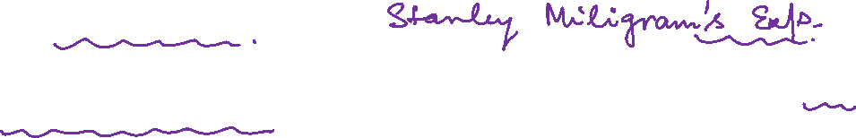
Graph Theory and its Applications
Recap : Milgram’s experiment
Stanley Milgram's Small world experiment, also known as the "six degrees of separation" experiment, was a social psychology study conducted in 1967 to investigate the idea that any two people in the world could be connected by a short chain of social connections.
Randomly chosen “starter” individuals to forward letter to “target person” living in Boston suburb.
Cannot directly mail –instead can only forward to a person he/she knows on 1st person basis and the process continues.
1/3rd of letters reached the target with median of 6 steps, hence the “six degrees”

Slide 5
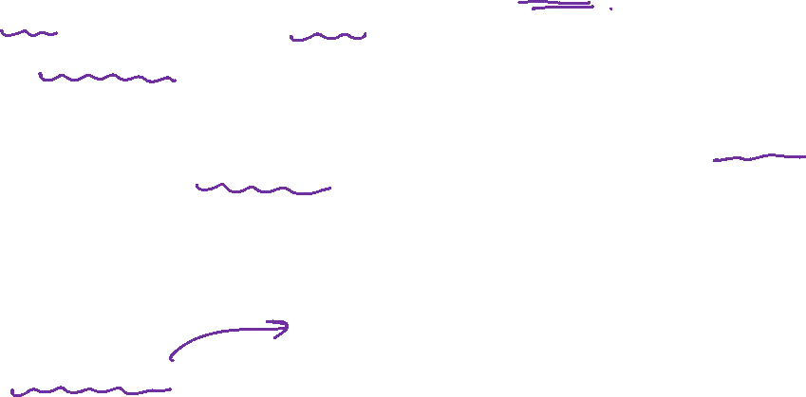
Graph Theory and its Applications
Small world effect that we see
In many networks the typical network distances between vertices are surprisingly small
Small world effect
In math terms the small world effect is a hypothesis meaning that the mean distance is “small”
Typically networks have been found to have mean distance less than 20 – or in many cases less than 10 – even though the networks themselves have millions of nodes
Implications
rumor spread in a social networks
response time in the Internet etc.

Slide 6
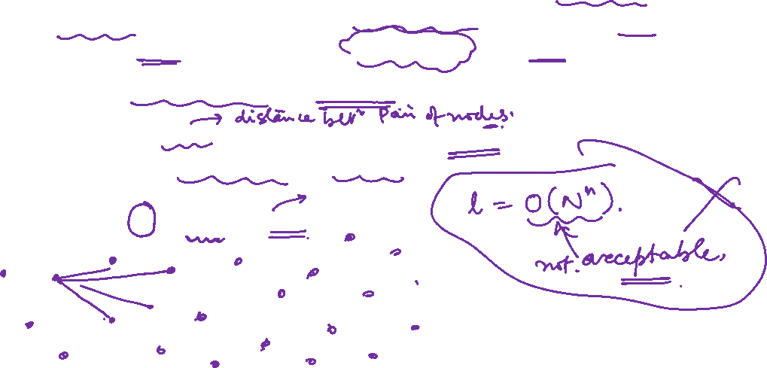
Graph Theory and its Applications
Small world effect that we see
In particular, a network is said to be a small-world network (or to satisfy the small-world property) if the mean geodesic distance between pairs of nodes is small relative to the total number of nodes in the network—
This length ℓ should not grow faster than logarithmically as the number of nodes tends to infinity.
That is, ℓ=O(logN) as N→∞.

Slide 7
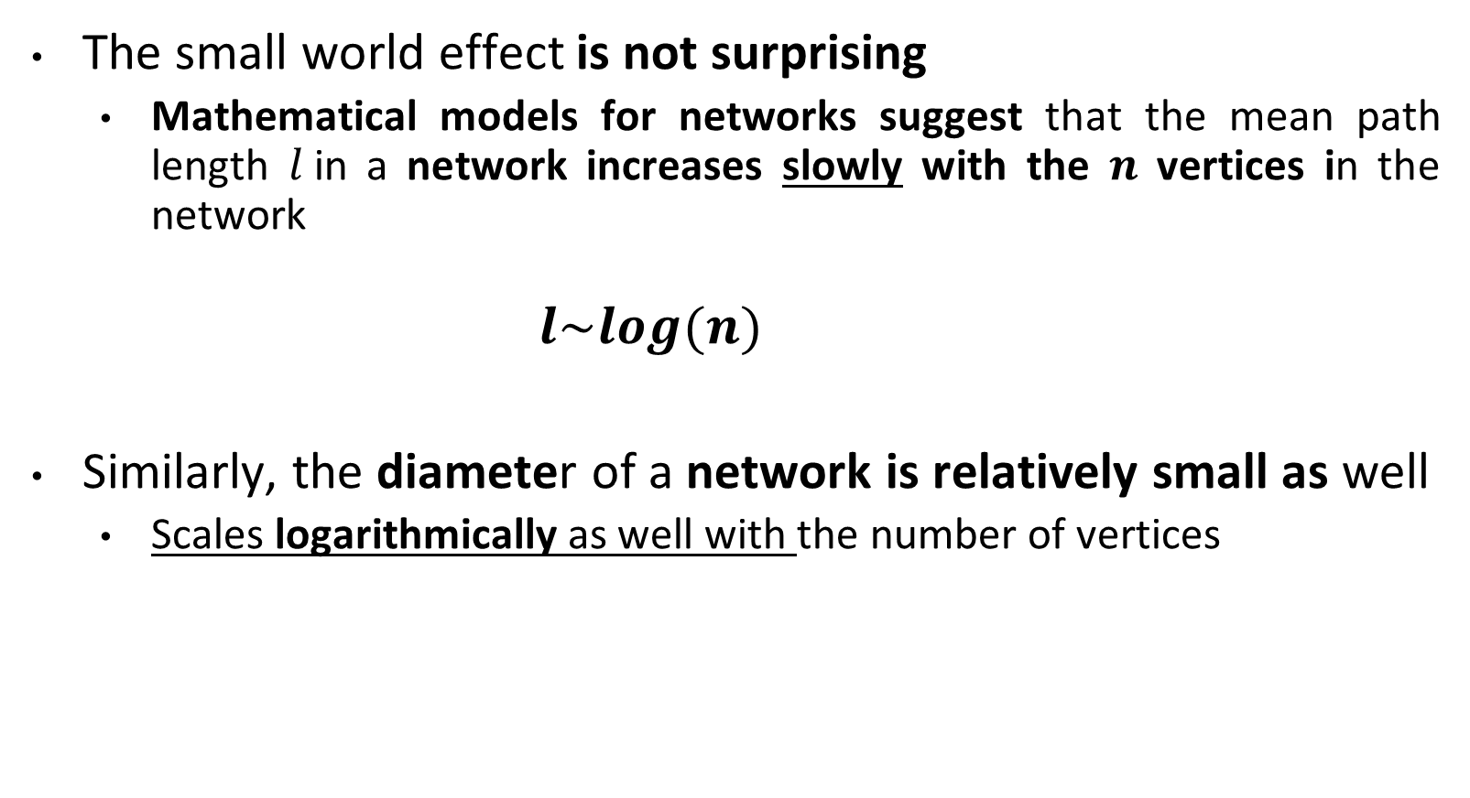
Graph Theory and its Applications
Small world effect is not surprising
The small world effect is not surprising
Mathematical models for networks suggest that the mean path length $l$in a network increases slowly with the $n$ vertices in the network
$$l\sim log(n)$$
Similarly, the diameter of a network is relatively small as well
Scales logarithmically as well with the number of vertices

Slide 8
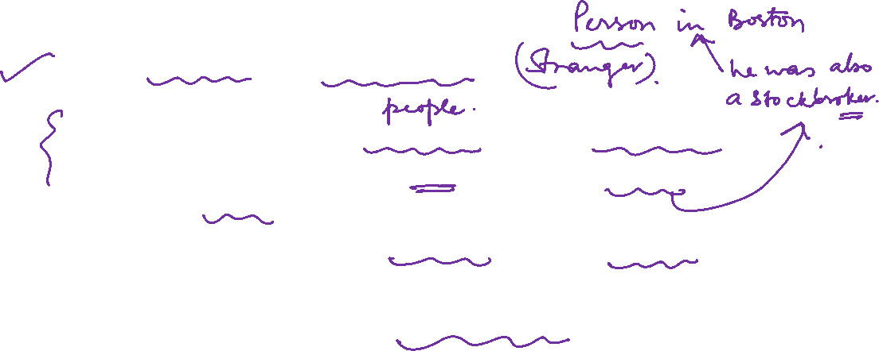
Graph Theory and its Applications
Issues with Milgram’s Experimental set up
A large fraction of his test subjects were stockbrokers
So are likely to know how to reach the “goal” stockbroker
A large fraction of his test subjects were in Boston
As was the “goal” stockbroker
A large fraction of letters never reached

Slide 9
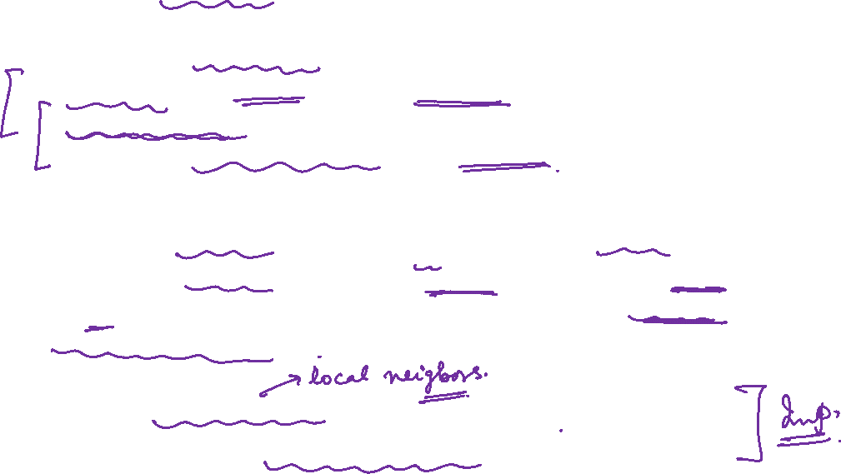
Graph Theory and its Applications
Key Findings of Milgram’s Small World Experiment
Demonstrated two key facts
Small world - Short paths are there in abundance
Decentralised search - People acting without any sort of global map are effective at collectively finding these short paths
Though Milgram’s experiment is supposed to test the hypothesis that people are connected by short paths on global social network , it is also an empirical study of people’s ability to collectively solve a problem ( example – searching for a path to a far-off individual)
By using only local information ( the alters of an ego ?)
By communicating only with the neighbours in the social graph

Slide 10
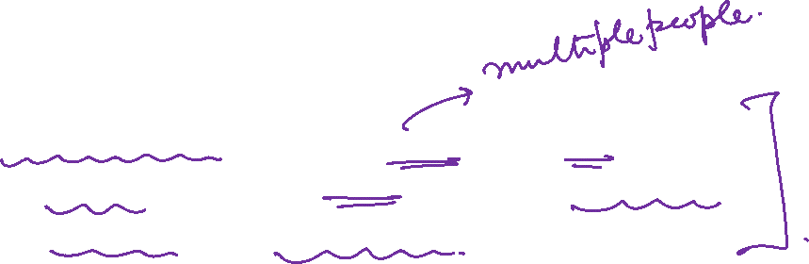
Graph Theory and its Applications
Key Findings of Milgram’s Experiment
Little explanation of Decentralized search in Milgram’s Experiment
In a decentralized search, multiple agents or actors work independently to gather information/complete a task, with no central control or coordination.

Slide 11
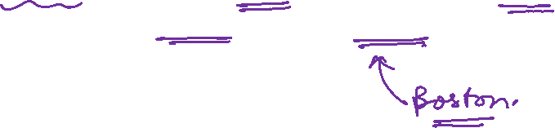
Graph Theory and its Applications
Key Findings of Milgram’s Experiment
In Milgram's experiment, participants were acting as independent agents who were asked to connect with a target person in Boston by sending a letter through social connections.
Participants were instructed to send the letter to someone they knew who they thought was more likely to know the target person, and so on, until the letter reached the target person.

Slide 12
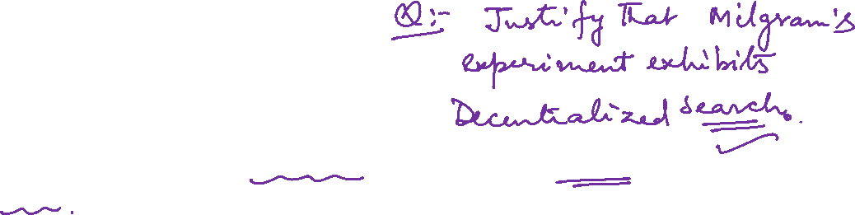
Graph Theory and its Applications
Key Findings of Milgram’s Experiment
In this sense, the Small world experiment could be seen as a decentralized search, with participants acting as independent agents who were searching for the correct social connections to reach the target person.
However, it is important to note that the experiment was not designed with this framework in mind, and it is only a loose analogy.
The Small world experiment was primarily focused on the social connections between people, rather than a task or information search.

Slide 13
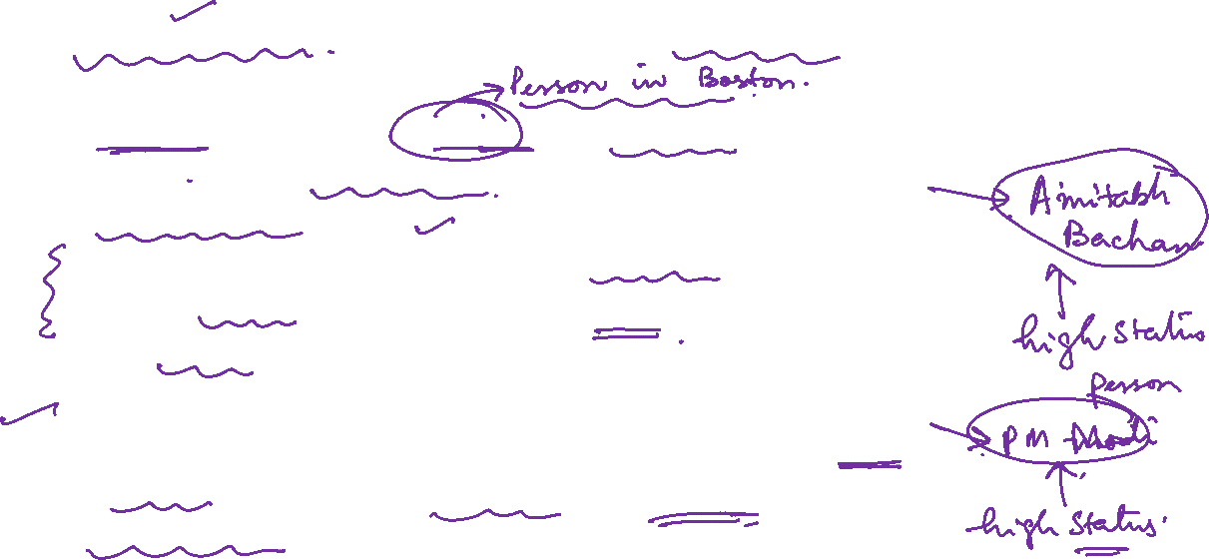
Graph Theory and its Applications
Milgram’s experiment was more successful with high status nodes
Success rate at finding targets in recreations of Milgram experiments has often been lower
Lack of participation
Milgram style experiment is successful when the target is of socially high status and low success when the reverse is true
Variation in success rate is based on the fact that social networks are structured to make high status individuals much easier to find

Slide 14
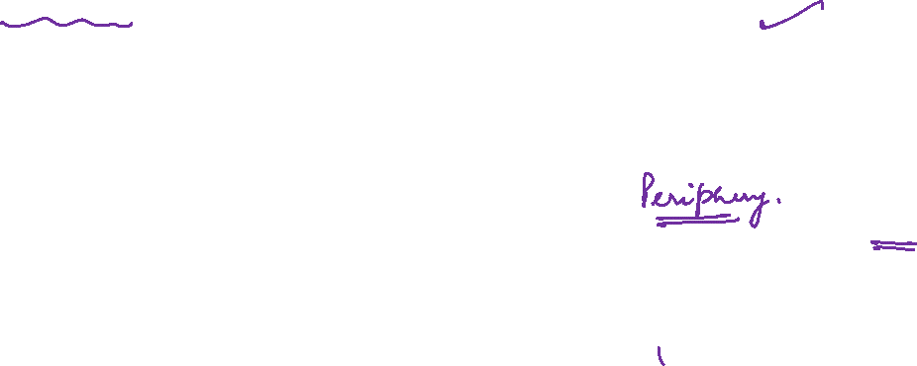
Graph Theory and its Applications
Core and Periphery structure in social networks
High Status nodes
Homophily suggests that high status people connect to high status folks and low status people mainly connect to low-status people – the real-world social networks do not display such symmetry.
Instead, there is a dense core of highly interconnected high-status people with low status people forming periphery.
Low status people do not form the core and are more fragmented while crowding around core of high status people
Low Status Nodes

Slide 15
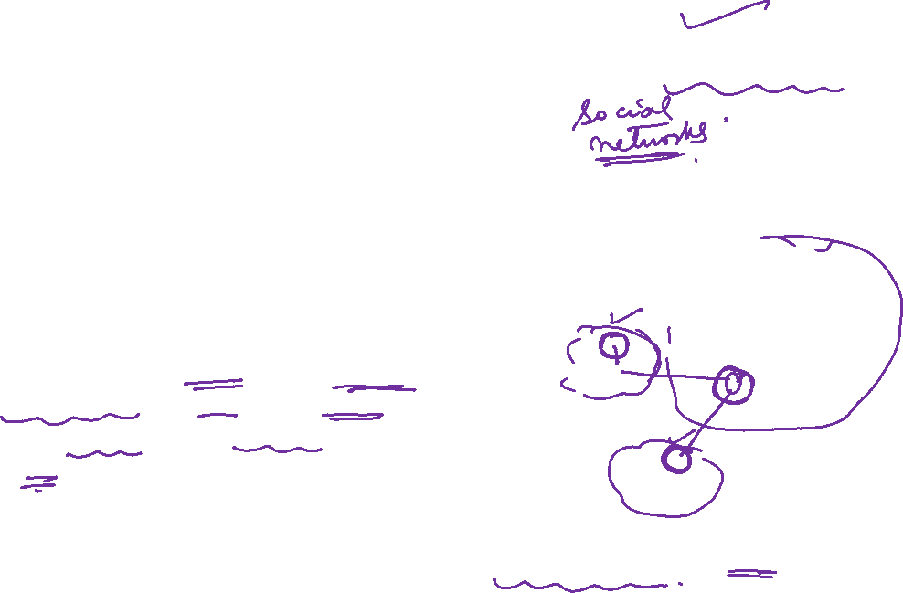
Graph Theory and its Applications
Core and Periphery structure in social networks
High Status nodes
Social networks are structured into core periphery where core consists of densely connected (through social foci such as club, interest, occupation, education etc.) high status people whereas periphery consists of low status folks clustered around the core.
Shortest path connecting two low status folks tend to go into the core and come out again as the cores are like exchanges in telephone networks
Low Status Nodes

Slide 16
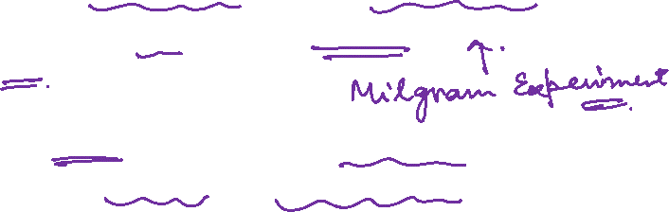
Graph Theory and its Applications
Core and Periphery structure in social networks
High Status nodes
As we move towards high status target, the link structure tends to become richer. Conversely, as we move to low status target, the link structure tends to become impoverished.
So low status “source” to low status “destination” does not show equal success rate !
This explains why Milgram experiment is more successful with high status folks.
Low Status Nodes

Slide 17
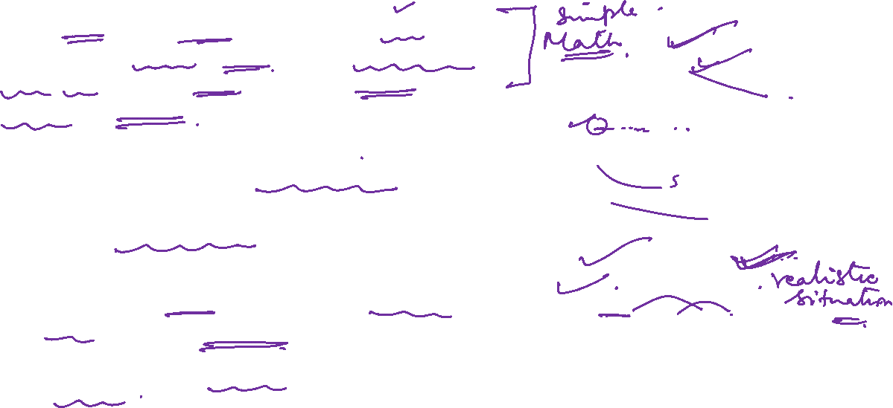
Graph Theory and its Applications
Why Milgram’s experiment result was a surprising discovery ?
Mathematically, if each of us knows 100 people, you can reach 10,000 in 2 steps and 100*100*100 = 1,000,000 people in 3 steps. This means reaching ten billion in 5 steps !
However, social graphs are full of triangles (many of my 100 friends know each other and not necessarily folks in the rest of the world ! )
Triadic closure limits the number of people one can reach by following “short paths”
This is the reason, results of Milgram’s experiment is surprising !

Slide 18
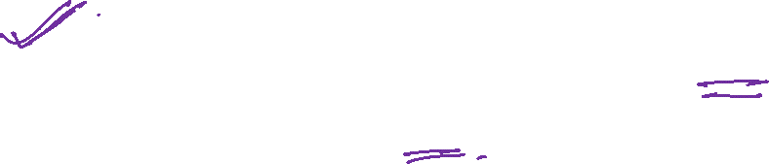
Graph Theory and its Applications
Does Watts and Strogatz Small World Model explain or capture the Milgram’s experiment fully ?
https://ww2.amstat.org/mam/04/essays/smallworld.pdf
Dr. Arti Arya
Department of Computer Science and Engineering

Slide 19
Graph Theory and its Applications
A Quick Recap:
Model | Degree distribution (power law) | High average clustering coefficient | Small average path length
Random Graph model | No | No | Yes
Small world model | No | Yes | Yes
Preferential Attachment Model | Yes | No | Yes

Slide 20

Graph Theory and its Applications
Recap : Watts and Strogatz small world model
There are many triads in the network and it limits the number of nodes that a node can reach.
Still there exists short path connecting every pair of nodes on the graph
Crux of Watts and Strogatz model : introducing a tiny amount of randomness in the form of long range weak ties is enough to make the world small !
Watts and Strogatz model starts with a regular lattice and rewires the edges with a probability beta
If β = 0, completely regular network (no power law, high average path, high clustering coeff)
If β =1 , completely random network ( no power law, low average path, low clustering coeff)
Small world network’s β is somewhere in the middle (no power law, low average path, high clustering coeff)

Slide 21
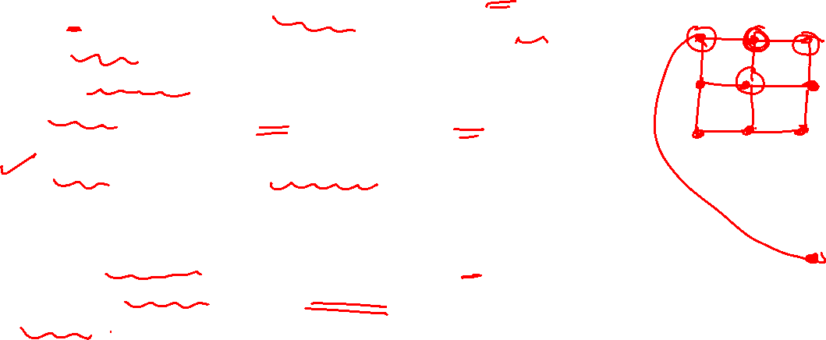
Graph Theory and its Applications
A simple grid-based model
Idea : Can we make up a simple model that exhibits both the features i.e. many closed triads but also many short paths in Watts and Strogatz Model ?
A simple grid based model
2 nodes are one grid step apart if they are adjacent and directly connected
Homophily is defined as r grid steps
Weak ties - For some constant value k, each node forms links to k other nodes on random basis ( rewire k links)
It is a hybrid structure – consisting of small amount of randomness sprinkled into an underlying structured pattern

Slide 22
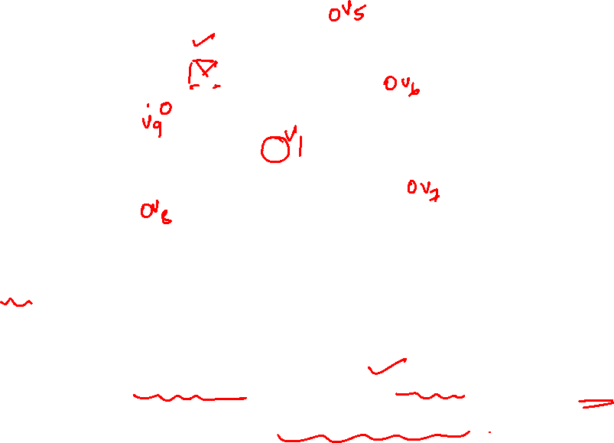
Graph Theory and its Applications
Watts and Strogatz model – how many random connections ?
Mathematically it was shown that it requires very small amount of randomness to achieve the small world effect - instead of every node having k weak ties, one in k nodes to have a single weak tie will achieve the same quantitative effect.

Slide 23
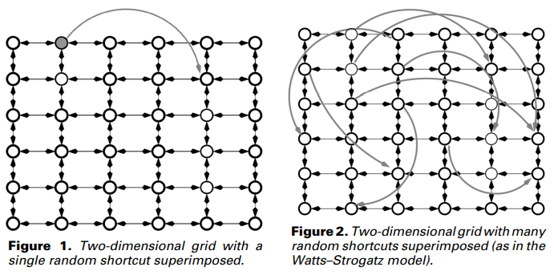
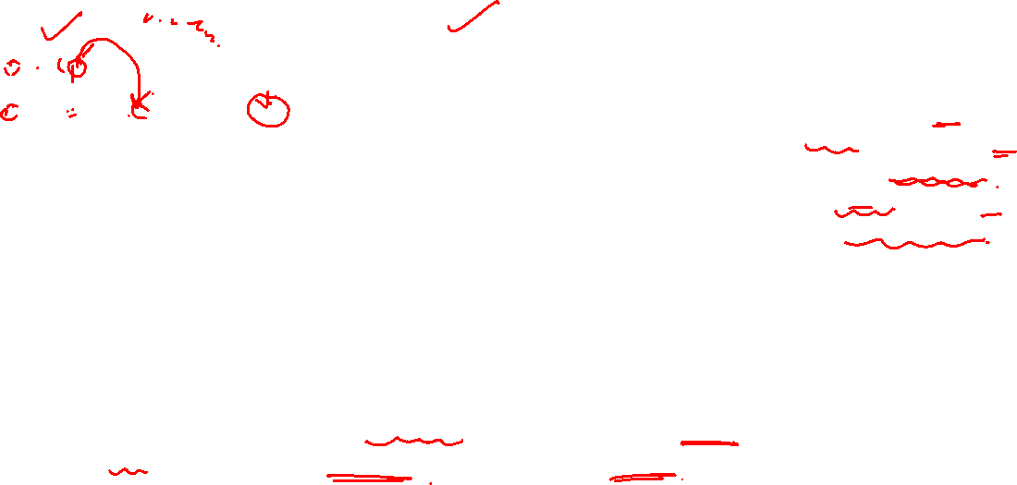
Graph Theory and its Applications
Watts and Strogatz model – how many random connections ?
Start with a d-dimensional lattice network and add a small number of long-range links out of each node, to destinations chosen uniformly at random.
A network created by this superposition will have local clustering and short paths, just like many of the networks found in the real world. (See Figures 1 and 2.)

Slide 24
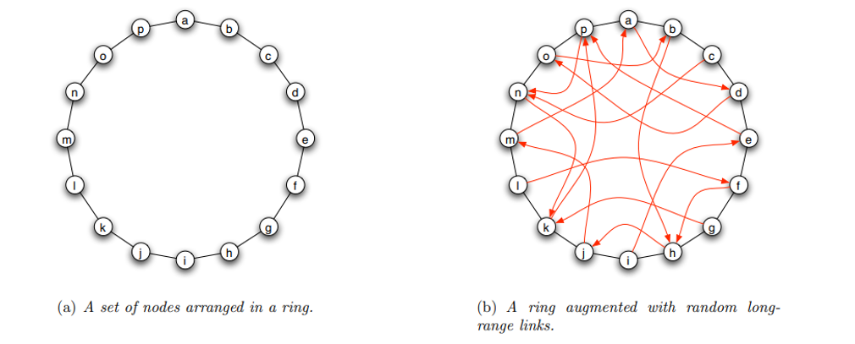
Graph Theory and its Applications
WS Model in One Dimension
A set of n nodes are arranged on a one dimensional ring, with each node connected by directed edges to the two others immediately adjacent to it.

Slide 25
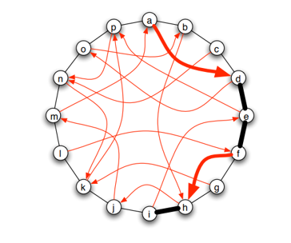
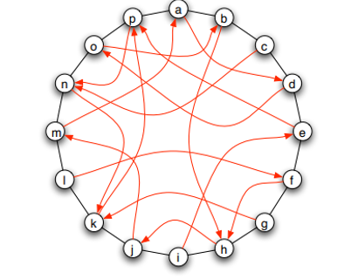
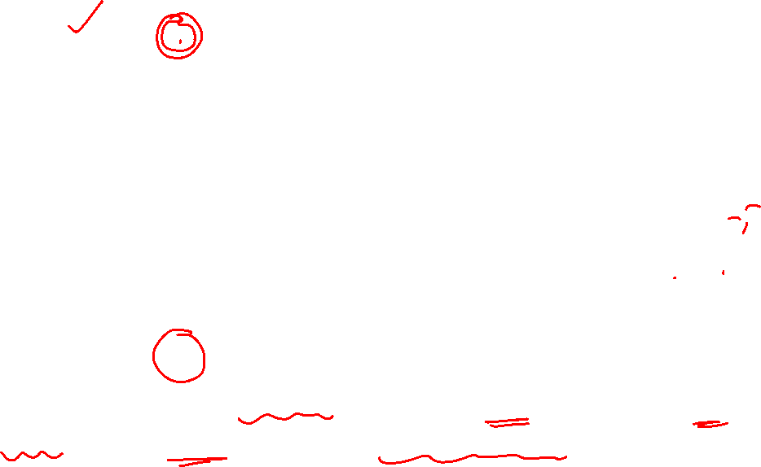
Graph Theory and its Applications
WS Model in One Dimension
The 2nd figure shows the myopic path that would be constructed if we chose a as the start node and i as the target node in the network

Slide 26
Graph Theory and its Applications
Theorizing Milgram’s experiment for Decentralized Search
Milgram’s experiment – essentially people were able to collectively find short paths to the designated target
This was kind of social search
Together they “tunnelled through” the network to reach the destination !
Naïve method – everybody sending to all of his friends and so on. This is flooding the network or breadth first search. This was not a feasible way.
So the people were instructed to advance the letter to just one person
In fact they chose based on their own understanding of the target and the suitability of his/her neighbours !

Slide 27
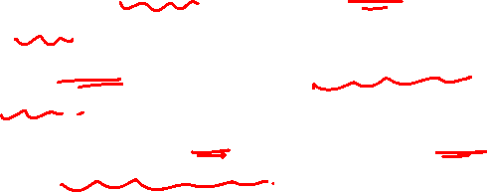
Graph Theory and its Applications
Where does the Watts and Strogatz model fail ?
Watts and Strogatz model’s working
A starting node s has to pass an information to target t
S knows only about all its neighbours and not more
Given the above setup, it takes a large number of steps to reach a target ( much larger than what Milgram found ).

Slide 28
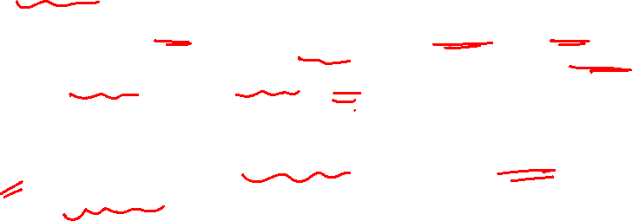
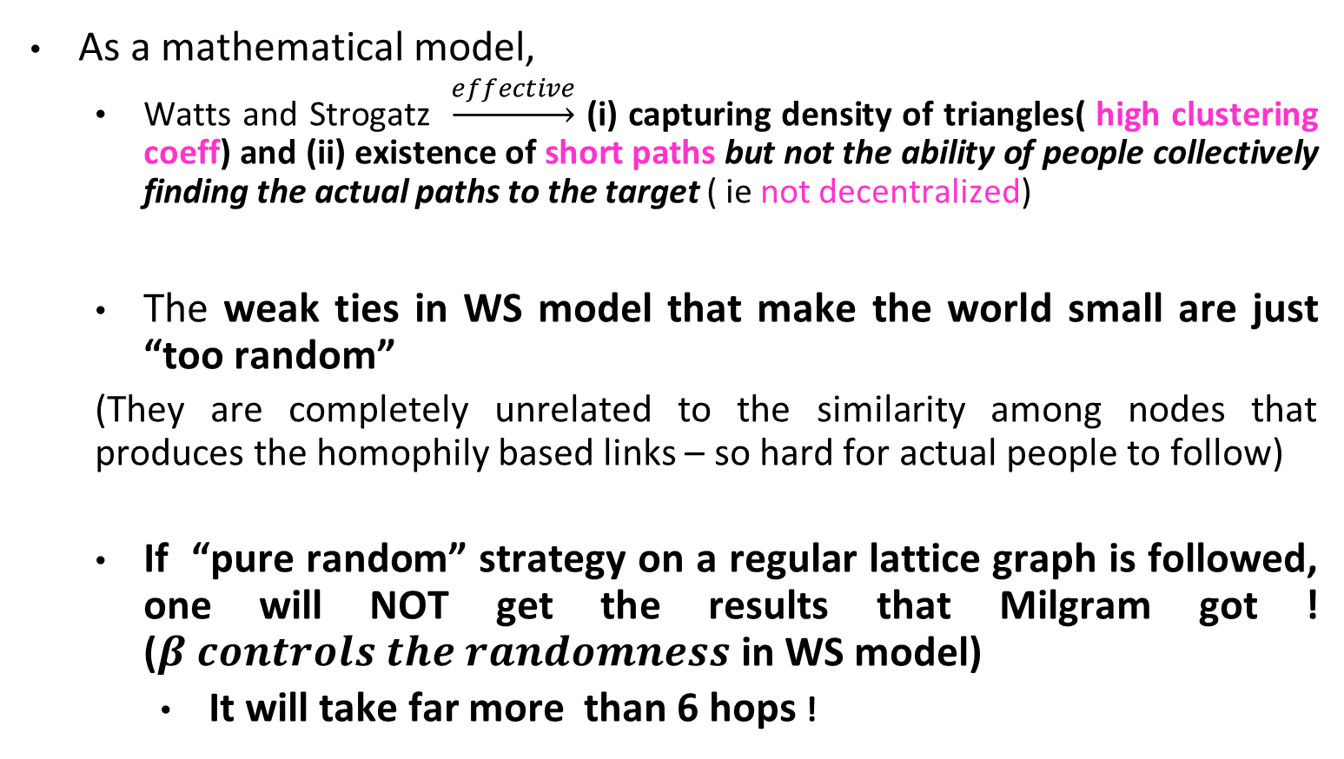
Graph Theory and its Applications
Where does the Watts and Strogatz model fail ?
As a mathematical model,
Watts and Strogatz $\underset{→}{effective}$ (i) capturing density of triangles( high clustering coeff) and (ii) existence of short paths but not the ability of people collectively finding the actual paths to the target ( ie not decentralized)
The weak ties in WS model that make the world small are just “too random”
(They are completely unrelated to the similarity among nodes that produces the homophily based links – so hard for actual people to follow)
If “pure random” strategy on a regular lattice graph is followed, one will NOT get the results that Milgram got ! ($β controls the randomness$ in WS model)
It will take far more than 6 hops !

Slide 29
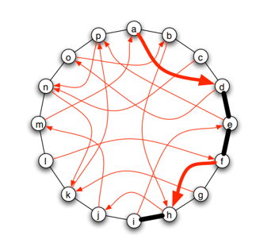
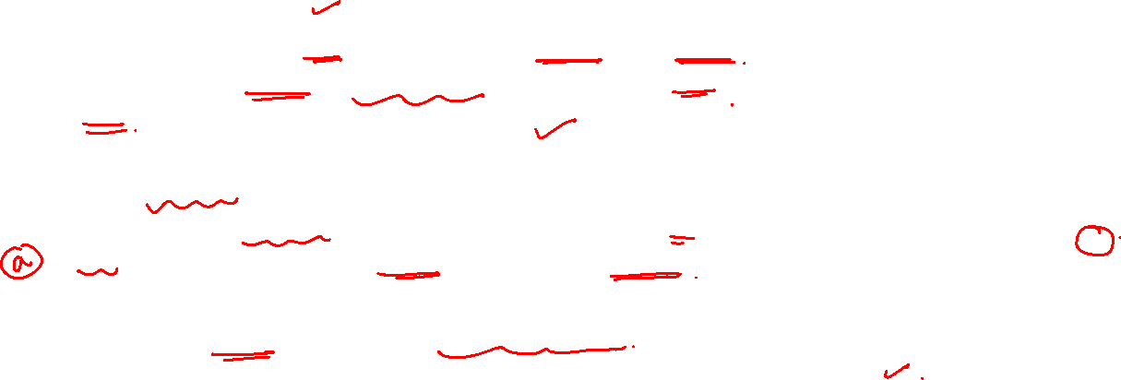
Graph Theory and its Applications
Decentralized and Myopic search
Assume that each node only knows his set of local contacts, the location of his long-range contact, and the location of the target
Crucially, he does not know the long-range contacts of the subsequent nodes.
In decentralised or myopic search, the current message-holder chooses the contact that is closest to the target and forwards the message to it.
This works recursively till the target is reached
It is also called myopic search (Myopia = short sightedness) as well as decentralised search (as every node on the path has a role to lay in the collective search of the shortest path)

Slide 30
Graph Theory and its Applications
Decentralized and Myopic search(FYI)
Myopic search refers to a behavior where individuals only consider their immediate neighbors or contacts when making decisions or taking actions, leading to a limited or short-sighted view of the network structure beyond their local connections.
Decentralized search, on the other hand, refers to the process of information seeking or decision making that takes place without centralized coordination or control. In a decentralized search process, individuals are able to make decisions or take actions based on their local knowledge and interactions with their immediate neighbors, without relying on a central authority or global information.
While both myopic search and decentralized search can occur in small world networks, they are distinct concepts. Myopic search is a behavior or tendency that individuals may exhibit, whereas decentralized search is a process that can occur in the absence of centralized control or coordination.

Slide 31
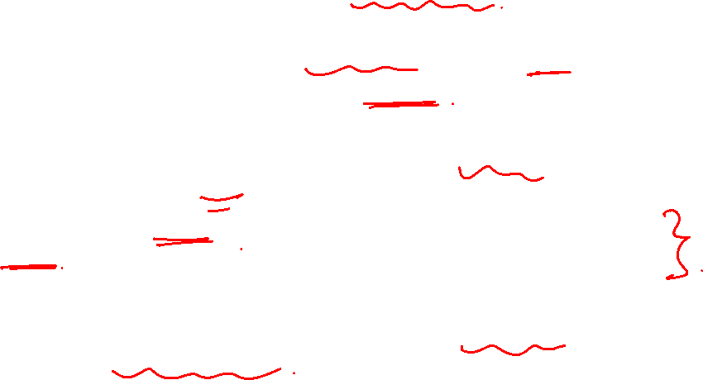
Graph Theory and its Applications
Mild Generalization of Watts and Strogatz Model
A mild generalization of the Watts & Strogtaz model can model Milgram’s experiment better
Note that every node in the hop chooses the next node ( shortest path ) based on some criteria i.e. his understanding of the target and his neighbors.
So, the “random” path chosen by each hop varies and that is not truly random !!
We generalize the W& S model by introducing one extra quantity that controls the “scales” spanned by long distance weak ties.
On the grid model, now each of the k random edges generated decay with distance

Slide 32
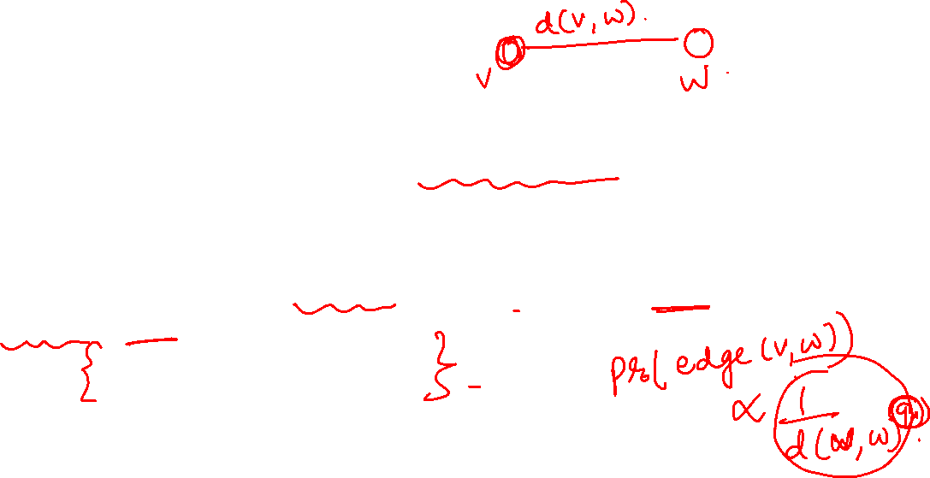
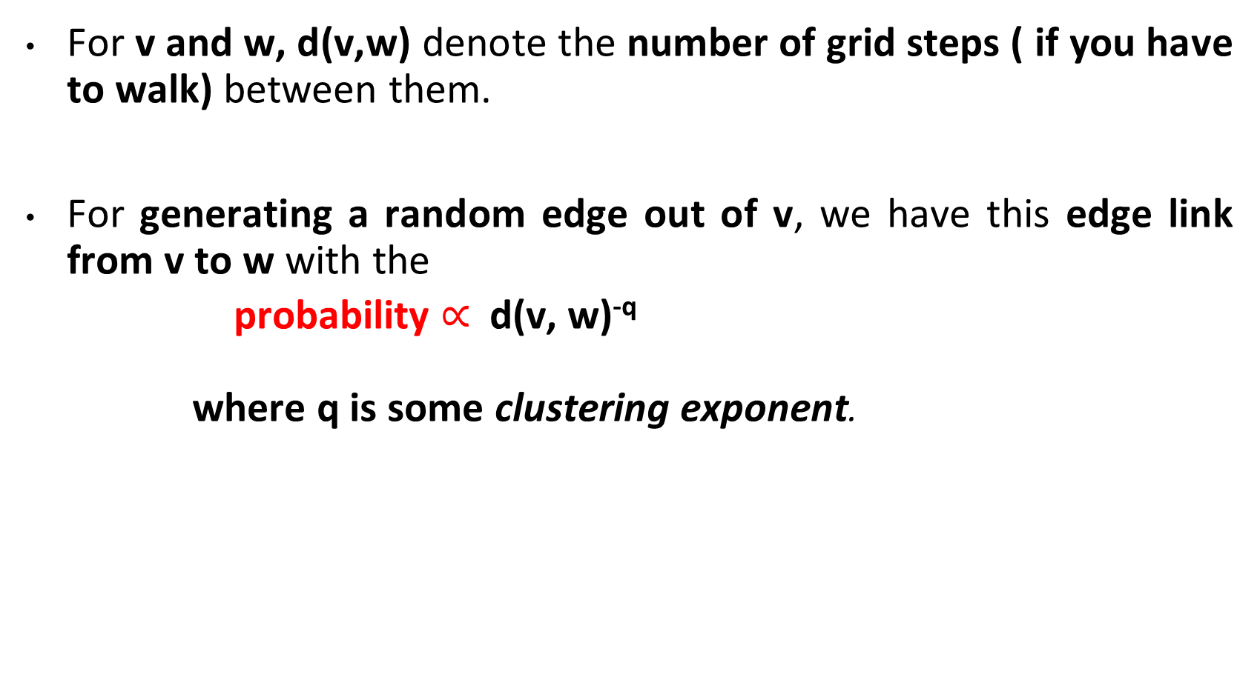
Graph Theory and its Applications
Generalizing W&S model
For v and w, d(v,w) denote the number of grid steps ( if you have to walk) between them.
For generating a random edge out of v, we have this edge link from v to w with the
probability $∝$d(v, w)^{-q}
where q is some clustering exponent.

Slide 33
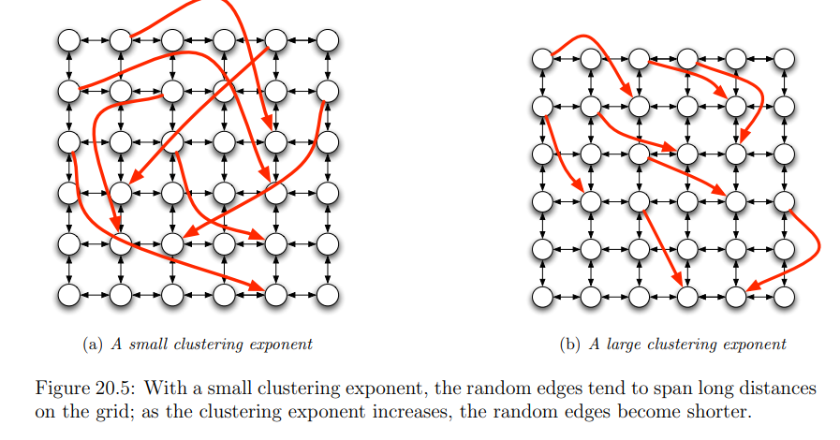
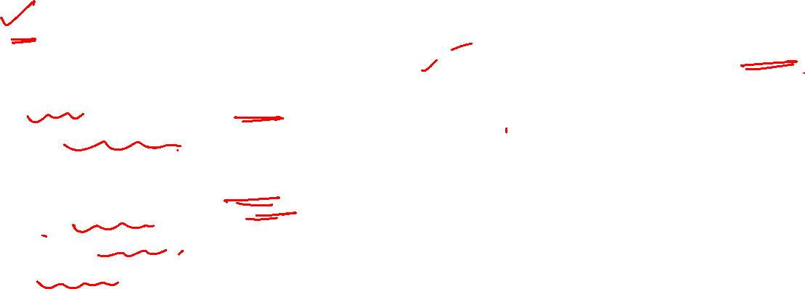
Graph Theory and its Applications
Generalizing W&S model
Different models for each value of clustering exponent q
q=0 is the original W&S model( grid based model where links are chosen uniformly at random);
q= small, random edges tend to span longer distance
q= large , they are shorter.
q = very small, the long range links are too random for an effective decentralised search;
q=very large, the long range links are not random enough
q=small q= large

Slide 34
Graph Theory and its Applications
Organize real world into different ‘scales of resolution’
We can mentally organize distances into blocks
Across the world
Across the country
Across the state
Across the town
Across the block
Similar to consider groups of nodes at increasingly larger distances
Nodes at distances 0-2, 2-4, 4-6, 6-8 and so on
Effectively decentralized search ‘funnels inwards’ through these different scales of resolution ( somewhat like a factor of 2 in each step)

Slide 35
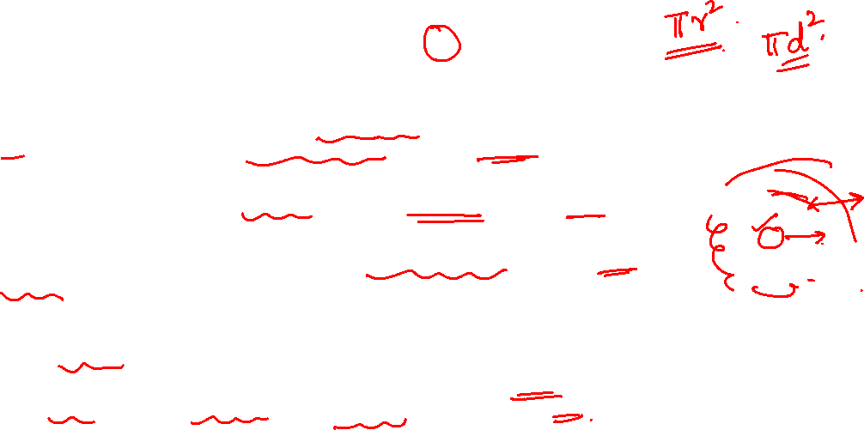
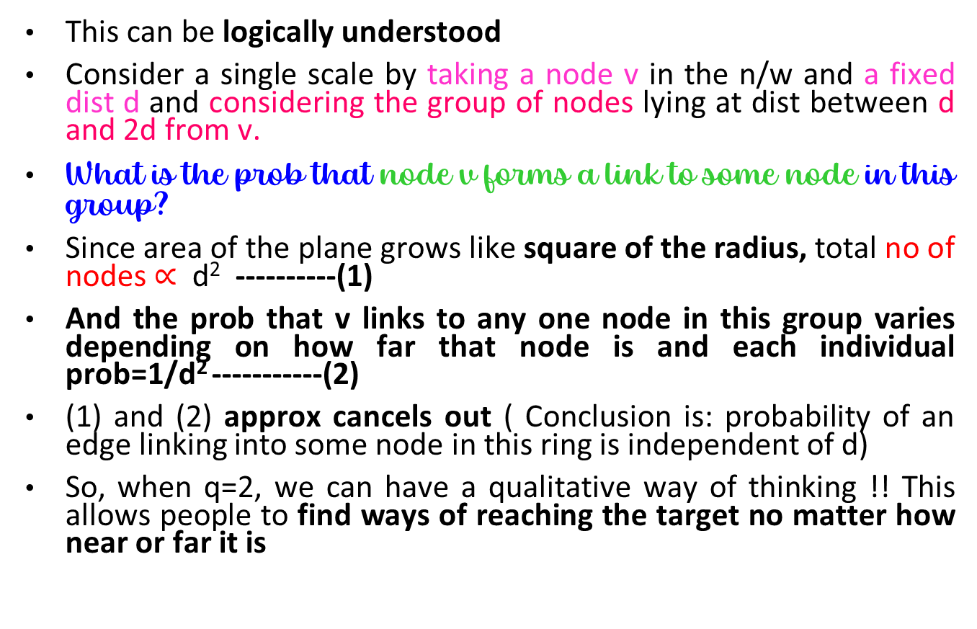
Graph Theory and its Applications
Intuitive understanding of why number 2 is important
This can be logically understood
Consider a single scale by taking a node v in the n/w and a fixed dist d and considering the group of nodes lying at dist between d and 2d from v.
What is the prob that node v forms a link to some node in this group?
Since area of the plane grows like square of the radius, total no of nodes $∝$ d² ----------(1)
And the prob that v links to any one node in this group varies depending on how far that node is and each individual prob=1/d² -----------(2)
(1) and (2) approx cancels out ( Conclusion is: probability of an edge linking into some node in this ring is independent of d)
So, when q=2, we can have a qualitative way of thinking !! This allows people to find ways of reaching the target no matter how near or far it is
No. of nodes proportional to d²
d
d
w
v
2d
Probability of linking to each node proportional to d⁻²

Slide 36
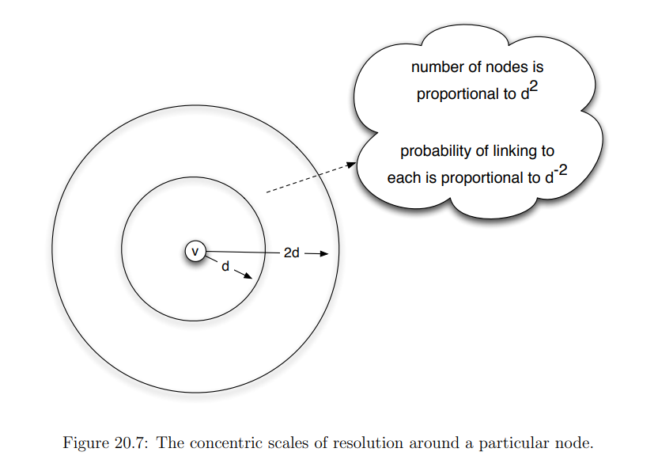

Slide 37
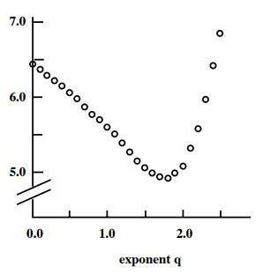
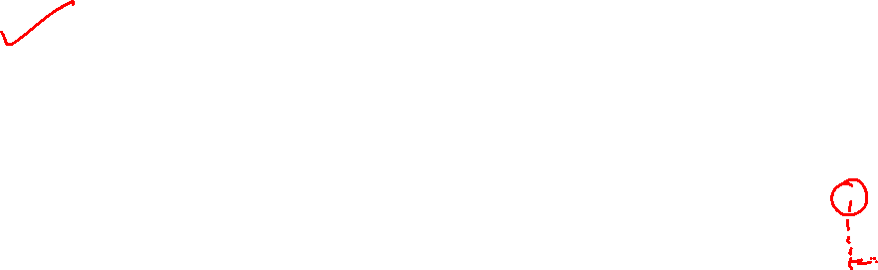
Graph Theory and its Applications
Generalizing W&S model
What makes 2 an optimum choice for q that is best for decentralized search
Path length of the process
Is there an optimum q ?
It is found that the best performance occurs when q is slightly less than 2 ( very close to 2)

Slide 38
Graph Theory and its Applications
Intuitive understanding of why number 2 is important
No of nodes proportional to d²
Thus an inverse-square distribution of links with distance makes effective decentralized search possible.
d
d
w
v
2d
Probability of linking to each node proportional to d⁻²

Slide 39
Graph Theory and its Applications
Qualitative way of thinking about the network for q=2
The network that arises when q=2
long range weak ties are being formed in a way that is spread roughly uniformly over all different scales of resolution
This allows people forwarding their messages to consistently find ways of reducing the distance to the targets , no matter how near or far they are from it !
What we have skipped ?
An involved proof is needed to show why an inverse square distribution of links with distance makes effective decentralised search. We did only an intuitive understanding (;-
There are empirical study that analyzed geographic data to look for this magic value of the exponent
There are also advanced analysis ( Ref 20.7 in the text Networks, Crowds and Markets ) using models of different dimensions to prove the same

Slide 40
Graph Theory and its Applications
The Optimal Exponent in One Dimension(FYI)
A set of n nodes are arranged on a one dimensional ring, with each node connected by directed edges to the two others immediately adjacent to it.
Each node v also has a single directed edge to some other node on the ring; the probability that v links to any particular node w is proportional to d(v, w) ⁻¹ , where d(v, w) is their distance apart on the ring

Slide 41
Summarizing Generative Models

Slide 42
Graph Theory and its Applications
Summarizing generative models -1
We discussed three well-established models that generate networks with commonly observed characteristics of real-world networks:
random graphs,
the small-world model, ( augmented this with myopic search).
preferential attachment
Random graphs assume that connections are completely random. We discussed two variants of random graphs:
G(n, p)
G(n,m).
Random graphs exhibit a Poisson degree distribution with large n , underestimates clustering coefficient p, and gives a realistic average path length

Slide 43
Graph Theory and its Applications
Summarizing generative models -2
Small world model assumes that individual nodes have fixed no of local connections in addition to random long ( global) connections.
This model generates networks with high transitivity and short path lengths, both commonly observed in real-world networks.
Small-world models are created through a process where a parameter controls how edges are randomly rewired from an initial regular ring lattice.
Empirically, when between 1% to 10% of edges are rewired (0.01 <= <= 0.1), the model resembles many real-world networks.
Unfortunately, the small-world model generates a degree distribution similar to the Poisson degree distribution observed in random graphs.
So, it gives acceptable average clustering coefficient and average path length but unrealistic degree distribution

Slide 44
Graph Theory and its Applications
Summarizing generative models -3
The preferential attachment model assumes that friendship formation likelihood depends on the number of friends target individuals have.
The model generates a scale-free network; that is, a network with a power-law degree distribution.
The preferential attachment model also exhibits realistic average path lengths that are smaller than the average path lengths in random graphs.
The basic caveat of the model is that it generates a small clustering coefficient, which contradicts high clustering coefficients observed in real-world networks.

Slide 45
Graph Theory and its Applications
Nobody is perfect (;-
Model | Degree distribution (power law) | High average clustering coefficient | Small average path length
Random Graph model | No | No | Yes
Small world model | No | Yes | Yes
Preferential Attachment Model | Yes | No | Yes
Random Graph model : only small average path length is ok
Small world model : adds in one more good thing i.e. large clustering coefficient but degree distribution is not following power law
Preferential Attachment Model : both degree distribution and small average path length are ok but does not generate large clustering coefficient

Slide 46
Graph Theory and its Applications
Summarizing myopic search
Goal is to theorize Milgram experiment, is to forward message from start node to target
Each intermediate node only knows the location of its own neighbours and location of the target ( nothing more about the network)
Forwarding strategy is a technique called myopic search
when a node v is holding the message, it forward to the contact that is closest to target t on ring.
This strategy is a reasonable approximation of the strategies used by people in Milgram’s experiment
Often the myopic path does not yield the real shortest path ( due to lack of knowledge about the network )
But in expectation ( detailed math in Advanced Material : Analysis of decentralized search in Textbook) , myopic search yields paths that are surprisingly short

Slide 47
THANK YOU
Dr. Arti Arya
Department of Computer Science and Engineering

